Slide 1
Introduction to Agile
Areej Aldaghamin
Ekaterina Mikhaylova
Jorge Maldonado Carranza

Slide 2
Table of Content
1
Introduction to Agile
2
Scrum
3
Kanban
4
Scrumban
5
Case study

Slide 3
The genesis of Agile is found in a group of software development methodologies [1] Introduction to Agile: Introduction to Agile
Agile tools and techniques can be applied to projects in general [1]
Agile methodology is based on iterative development with which requirements and solutions evolve through collaborative environment [1]
Agile theory is based on the Agile manifesto [1]
Agile supports self-organizing and cross-functional teams [1]

Slide 4
The agile manifesto was written in February 2001 by 17 independent-minded partitioners with mostly programming background [1] Introduction to Agile: Introduction to Agile
Practitioners differed on what constitutes agile theory but agreed on four main values:
Change[1]
Individuals and interactions [1]
Customer involvement [1]
Working software over documentation [1]

Slide 5
The principles provide a better understanding of the framework and intention of agile methods [x] Introduction to Agile: Introduction to Agile
1.
Our highest priority is to satisfy the customer [1]
We welcome changing requirements even late in development [1]
Deliver working software frequently from a couple of weeks to a couple of months with a preference for the shorter time scale [1]
Business people and developers must work together daily throughout the project [1]
Build projects around motivated individuals [1]
The most efficient and effective method of conveying information to and within a development team is face-to-face conversation [1]
2.
3.
4.
5.
6.

Slide 6
History on how these 12 principles were developed originally remains a bit fuzzy [1] Introduction to Agile: Introduction to Agile
7.
Working software is the primary measure of progress [1]
Agile processes promote sustainable development [1]
Continuous attention to technical excellence and good design enhances agility [1]
Simplicity—the art of maximizing the amount of work not done – is essential [1]
The best architectures, requirements, and designs emerge from self-organizing teams [1]
At regular intervals, the team reflects on how to become more effective, then tunes and adjusts its behavior accordingly [1]
8.
9.
10.
11.
12.

Slide 7
There are several Agile methodologies and certifications [1] Introduction to Agile: Introduction to Agile
Some of the most common Agile methodologies include: [1]
Recognized entities that provide certifications in agile methodologies include but are not limited to: [1]
Scrum
Feature-Driven Development (FDD)
Extreme Programming (XP)
Dynamic System Development Method (DSDM)
Lean
Crustal
Kanban
Just-in-Time
Project Management Institute
Disciplined Agile
Platinum Edge
Agile Alliance
Scaled Agile Framework
Scrum Alliance

Slide 8
The most recognized word when Agile is applied to project management is Scrum [1] Introduction to Agile: Scrum
Scrum is a framework for developing, delivering, and sustaining complex products [2]
Scrum is lightweight, simple to understand but difficult to master [2]
It has been used to manage work on complex products since the early 1990s [2]
It makes clear the relative efficacy of the product management and work techniques to allow continuous improvement of the product, team, and working environment [2]

Slide 9
The Scrum framework involves roles, artifacts, and events [2] Introduction to Agile: Scrum
Sprint
Impediment Backlog
Burndown Chart
Daily Scrum
Task Board
Sprint Review
Product Owner
Sprint Backlog
Product Backlog
Product Increment
Development Team
Sprint Planning
Sprint Retrospective
Product
Scrum Master

Slide 10
Scrum teams deliver products iteratively and incrementally, maximizing opportunities for feedback [2] Introduction to Agile: Scrum
Role
Product Owner
Scrum Master
Development Team
Description
Responsible for maximizing the value of the product resulting from work of the Development Team. It is the sole person responsible for managing the Product Backlog. The Product Owner is a person, not a committee [2]
Is responsible for promoting and supporting Scrum. They help everyone understand Scrum theory, practices, rules, and values. The Scrum Master is a servant-leader for the Scrum Team. The Scrum Master helps those outside of the Scrum Team understand which of their interactions with the Scrum Team are helpful and which aren't” [2]
Consists of professionals who do the work of delivering a potentially releasable Increment of “Done” product at the end of each Sprint. Only members of a Development Team create the Increment. They are self-organized, cross-functional, and with no distinction in their titles. The size of the team goes from 3 to 9 persons [2]

Slide 11
Artifacts are specifically designed to maximize transparency of key information [2] Introduction to Agile: Scrum
Artifact
Product Backlog
Sprint Backlog
Task Board
Description
The Product Backlog is an ordered list of everything that is known to be needed in the product, and the Product Owner is responsible for it [2]
Is the set of Product Backlog items selected for the Sprint, plus a plan for delivering the product increment and realizing the Sprint Goal [2]
The overview of the individual tasks for developing functions can be displayed on a Task Board. This can be a flip, an excel sheet, or post-it note on the Scrum board with the heading “task”

Slide 12
Scrum’s Artifacts represent work or value to provide transparency and opportunities for inspection and adaptation [2] Introduction to Agile: Scrum
Artifact
Burndown Chart
Impediment Backlog
Product Increment
Description
Graphical control and steering instrument for the individual Sprints. It visualizes the work done and the work still to be done on a given date. The display usually takes the form of story points
Is the documentation of the obstacles during a Sprint in the form of a list. The obstacles refer to anything that prevents a team from completing the tasks. It can be a list on a flip, Excel sheet, a ticket in a task management tool, or a post-it note on a scrum board titled “Impediments”
An increment is the result of a sprint (partial delivery object). It comprises the functions and characteristics to fulfill the user stories of the Sprint. At the end of a Sprint, the increment must be in a working state and meet the team’s definition of “Done” [2]

Slide 13
All events are time-boxed, such that every event has a maximum duration [2] Introduction to Agile: Scrum
Event
Sprint
Spring Planning
Daily Scrum
Sprint Review
Sprint Retrospective
Description
A time box during which a “Done”, usable and potentially releasable product increment is created [2]
The work to be performed in a Sprint is planned here and it is done by the collaborative work of the entire Scrum Team [2]
A Daily Scrum is held every day of the Sprint, there the Development Team plans work for the next 24 hours [2]
Held at the end of the Sprint to inspect the Increment and adapt the Product Backlog if needed, feedback from customer [2]
Reflection of the current sprint, there improvements are identified, planned and implemented [2]
Time Boxing
Four weeks
At the beginning of Sprints 8h
Daily 15 min
End of Sprints 4h
End of Sprints 3h

Slide 14
Kanban is a popular framework used to implement agile and DevOps software development [3] Introduction to Agile: Kanban
Kanban requires real-time communication of capacity and full transparency of work [3]
Work items are represented visually on a Kanban board, allowing team members to see the state of every piece of work at any time [3]
Kanban methodology of work dates back more than 50 years, in the late 1940s Toyota optimized their process based on the supermarket model used to stock their shelves [3]
Toyota applied this system to its factory floor to align their massive inventory levels with the actual consumption of materials and to communicate capacity levels on real time workers would pass a card or “Kanban” between teams [3]

Slide 15
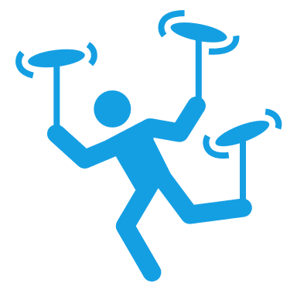
Agile development teams today can leverage these same JIT principles by matching the WIP to the team’s capacity [3] Introduction to Agile: Kanban
Taking care of the work in progress (WIP) limits gives team more flexible planning options, faster output, clearer focus, and transparency throughout the development cycle [3]
Makes it easier to identify inefficiency in a team’s workflow [4]
Sets the maximum amount of work that can exist in each status of a workflow [4]
Points out areas of chronic idleness or overload [4]
WIP limits
Allows to identify bottlenecks [4]
Encourage a culture of “done”[4]

Slide 16
The work of all Kanban teams revolves around a Kanban board, a tool used to visualize work and optimize the flow of the work among the team [5] Introduction to Agile: Kanban
3
Kanban boards can be broken down into five components [5]
4
2
5
1. Visual signs – Visual cards, stickies, tickets, etc. [5]
2. Columns – Each column represent a specific activity from the “workflow” [5]
3. Work In Progress (WIP) Limits – Maximum number of cards that can be in one column at any given time [5]
4. Commitment point – When an idea is picked up by the team and work starts on the project [5]
5. Delivery point – The end of the Kanban team’s workflow [5]
1

Slide 17
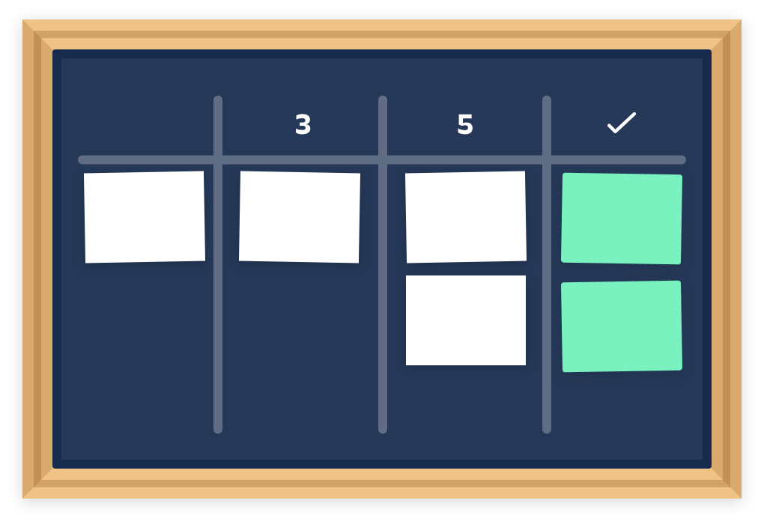
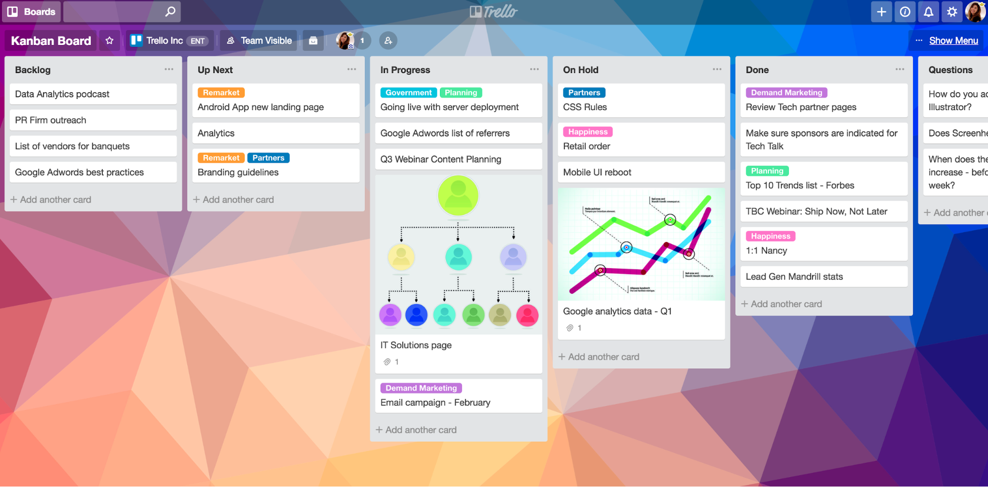
The type of environment adapting Kanban often dictates if the board is physical or digital [5] Introduction to Agile: Kanban
Physical Kanban Board
Digital Kanban Board
The simplest Kanban board is the physical one, divided into vertical columns with sticky notes that move throughout the workflow [5]
Through digital transformation, Kanban boards become digital, allowing teams that do not share a physical office space to use a board remotely and asynchronously [5]

Slide 18
In Japanese, Kanban literally translates to "visual signal“, for Kanban teams, every work item is represented as a separate card on the board [3] Introduction to Agile: Kanban
The main purpose of representing work as a card in a board is to allow team members to track progress of work through its workflow in a visual manner [3]
A Kanban card features critical information about a work item giving the entire team;
Visibility of who is responsible for that item [3]
A brief description of the work being done [3]
How long that piece of work is estimated to take [3]
And so on… [3]

Slide 19
Kanban offers several additional advantages to task planning and throughput for teams of all sizes [3] Introduction to Agile: Kanban
Planning flexibility
Shortened time cycles
Fewer bottlenecks
The Kanban team is only focused on the work that’s actively in progress. The product owner is free to reprioritize work in the backlog without disrupting the team [3]
Cycle time is a key metric for Kanban teams, being the amount of time it takes for a unit of work to travel through the workflow. By optimizing it, a team can confidently forecast the delivery of future work [3]
WIP limits highlight the bottlenecks and backups in the team’s process due to lack of focus, people, or skill sets [3]
19

Slide 20
Kanban is one of the most popular software development methodologies adopted by agile teams today [3] Introduction to Agile: Kanban
Visual metrics
Continuous delivery
Charts provide a visual mechanism for teams to ensure they’re continuing to improve, when a team can see data it’s easier to spot bottlenecks in the process and remove them. Two common reports used are control charts and cumulative flow diagrams [3]
Continuous delivery is the practice of releasing work to customers frequently, focusing on a just-in-time and one-at-a-time delivery of value. Kanban teams focus on optimizing the flow of work out to customers [3]
20

Slide 21
The difference between Kanban and Scrum is quite subtle [5] Introduction to Agile: Kanban
By most interpretations, Scrum Teams use a Kanban board with Scrum Processes, Artifacts and Roles along with it [5]
Some key differences between Scrum and Kanban include:
Scrum sprints have start and stop dates whereas Kanban is an ongoing process [5]
Team roles are clearly defined in Scrum while Kanban has no formal roles [5]
A Kanban board is used throughout the lifecycle of a project whereas a Scrum board is cleared and recycled after each sprint [5]
A Scrum board has a set number of tasks and strict deadline to complete them [5]
Kanban boards are more flexible with regards to tasks and timing since they can be reprioritized, reassigned, or updated as needed [5]

Slide 22
Some teams blend the ideals of Kanban and Scrum into “Scrumban” [3] Introduction to Agile: Scrumban
For Scrumban they…[3]
Take fixed-length sprints and roles from Scrum [3]
Focus on work in progress limits and cycle time from Kanban [3]

Slide 23
Case Study
“Module Development within OpenCoPs”

Slide 25
References
[1] Terra Vanzant Stern, P. (2020). Lean and Agile Project Management : How to Make Any Project Better, Faster, and More Cost Effective, Second Edition: Vol. 2nd ed. Productivity Press.
[2] Schwaber, K. and Sutherland, J., (2017). The Scrum Guide - The definitive Guide to Scrum: The Rules of the Game. [online] Scrumguides.org. Available at: <https://scrumguides.org/docs/scrumguide/v2017/2017-Scrum-Guide-US.pdf>.
[3] https://www.atlassian.com/agile/kanban
[4] https://www.atlassian.com/agile/kanban/wip-limits
[5] https://www.atlassian.com/agile/kanban/boards

Slide 26
Training on Jira
Areej Aldaghamin
Ekaterina Mikhaylova
Jorge Maldonado Carranza

Slide 27
Table of Content
1
Introduction
2
Key terms
3
Boards
4
Scrum vs Kanban
5
Roles in OpenCoPs
6
Walkthrough

Slide 28
Jira is a suite of agile work management solutions [1] Training on Jira: Introduction
Helps teams plan, assign, track, report, and manage work and powers collaboration[1]
Can be used for every type of team, from agile software development and customer support to enterprises [1]
Jira products include:
Jira Software – Built for members of an agile team to plan and track work [1]
Jira Service Management – Provides customers an easy way to ask for help and your agents a faster way to deliver it [1]
Jira Work Management – Built for managing any business project [1]
Jira Align – Enterprise Agile Planning platform that connects product, program, and portfolio strategy to technical execution, at scale [1]

Slide 29
Jira Software is the #1 tool for agile teams[1] Training on Jira: Introduction
Users
Use cases
Hosting
Integrations
Software developers
QA and testing
Project managers
Product designer
Product owners
Scrum masters [1]
Agile teams
Bug tracking
Project management
Product management
Process management
Software development
Requirements and test case management[1]
Cloud
Data center [1]
Confluence
Bitbucket
Trello
Slack
GitHub
Microsoft
Google [1]

Slide 30
Jira software allows to prioritize and discuss your team’s work in full context with complete visibility [2] Training on Jira: Introduction

Slide 31
Some key terms have a specific meaning when working with Jira Training on Jira: Key terms
Project
Collection of issues that are held in common by purpose or context [1]
Issues
Single work item of any type or size that is tracked from creation to completion [1]
Workflows
Represent a sequential path an issue takes from creation to completion [1]
Boards
Part of a project that displays issues giving teams a flexible way to view, manage, and reporting on work in progress [1]
Agile
Emphasis on an iterative approach to work [1]

Slide 32
Issue types distinguish different types of work in unique ways, and help you identify, categorize, and report on your team’s [7] Training on Jira: Key terms
Epic
Body of work that can be broken down into specific tasks[8]
Bug
Problem which impairs or prevents the functions of a product[7]
Story
Smallest unit of work that needs to be done, an end goal [7]
Subtask
Piece of work required to complete a task [7]
Task
Work that needs to be done [7]

Slide 33
There are three types of boards in Jira Software [3] Training on Jira: Boards
Team-managed board
For teams who are new to agile, gets the team up-and-running with a simplified board [3]
Scrum board
For teams that plan their work in sprints, it includes a backlog [3]
Kanban board
For teams that focus on managing and constraining their work-in-progress, it includes the option of a Kanban backlog [3]

Slide 34
The backlog is a list of work that represents outstanding work in a project [4] Training on Jira: Boards
List of issues
Detailed view

Slide 35
Jira scrum board is the tool that unites teams around a single goal and promotes iterative, incremental delivery [6] Training on Jira: Boards
Scrum boards can:
Increase communication and transparency since it can be accessed by any team member [6]
Promote sprint planning and iterative development [6]
Improve team focus and organization [6]

Slide 36
Scrum vs Kanban is a discussion about two different agile strategies[9] Training on Jira: Scrum vs Kanban
Criteria
Cadence
Release methodology
Roles
Key metrics
Change philosophy
Scrum
Regular fixed length sprints
At the end of each sprint
Product owner, scrum master, development team
Velocity
Teams shouldn’t make changes during the spring [9]
Kanban
Continuous flow
Continuous delivery
No required roles
Lead time, cycle time, WIP
Changes can happen at any time [9]

Slide 37
The product owner and the members of an OpenCoP perform different activities in Jira Training on Jira: OpenCoPs
A product owner must:
Set up roles (project roles)
Create and set up boards (status, columns, backlog, labels, components)
Manage the backlog
Create and assign issues
Release issues from a board
Task prioritization
Create reports
Report to the project leader
Members of an OpenCoP:
Work on tasks that were assigned to them by the product owner
Can select a task from a board and work on it
Update the status of their progress by moving the tickets through the board

Slide 38
Jira software is a quite intuitive tool that aids in work management Jira Software Basics: Walkthrough
Structure
How to create a project
How to set up roles
How to create and set up boards (status, columns, backlog, labels, components)
How to manage the backlog
How to create and assign issues
How to release an issues from a board
How to perform task prioritization
How to create reports

Slide 40
References
[1] https://www.atlassian.com/software/jira/guides/getting-started/overview
[2] https://www.atlassian.com/software/jira
[3] https://support.atlassian.com/jira-software-cloud/docs/what-is-a-jira-software-board/
[4] https://confluence.atlassian.com/jirasoftwareserver/creating-your-backlog- 938845071.html#:~:text=Your%20backlog%20is%20a%20list,have%20issues%20on%20your%20backlog.
[5] https://www.atlassian.com/agile/kanban/boards
[6] https://www.atlassian.com/software/jira/features/scrum-boards
[7] https://support.atlassian.com/jira-cloud-administration/docs/what-are-issue-types/
[8] https://www.atlassian.com/agile/project-management/epics
[9] https://www.atlassian.com/agile/kanban/kanban-vs-scrum

