Slide 1
OpenCoPs Roles
Abouzar Daneshpajouh

Slide 2
Roles in OpenCoPs
P
Planning
Team
Product Owner
Configuration Planner
Developers
Moderator
Teachers
Learning Steward
Reviewers
Release Communicator
Documentation Manager
IT Technology Steward
D
Development
Team
C
Training
Team
A
Review
Team
Enablers
Team

Slide 3
Roles in OpenCoPs – Planning Team
Has the overall responsibility for the requirements and the results.
The members of the OpenCoP ask the Product Owner about features and requirements and the Product Owner reviews and accepts the results.
Within the project descriptions a Product Owner is already defined for each eLearning module. Nevertheless, assigning the Product Owner is the responsibility of the Project Management Board (PMB).
Prepares Release & Configuration Management Plan, Release Schedule.
Schedule Releases and synchronize, e.g. with pilot teaching.
Track and Administration of different versions.
Putting the right releases together and managing all the dependencies.
Assembling the educational resources and didactic formats into a meaningful configuration which supports a certain competence delivery
Make Sure that the evaluation and the improvement plan fit to the right version of the educational resources
Curator of the module – tailored according to the needs.
Appointed by OpenCoPs

Slide 4
Roles in OpenCoPs – Development Team
The developers are all people who are contributing to the concepts and educational resources of the module. They can be part of the OpenCoP (especially the key developers) or external experts (e.g. doing video recording etc.). Their work is managed with the Scrumban process.
The group work might require a person dealing with the organisation and facilitation of meetings and the production process. This role is required if the tasks of the OpenCoP go beyond the scrum-style development of one artefact.

Slide 5
Roles in OpenCoPs – Training Team
The teachers are using the modules and educational resources for teaching and training. They can be members of the OpenCoP (and also developers) but the dissemination and exploitation strategy aims at enlarging the pool of teachers constantly. Within the co-production cycle, the teachers also contribute with the pilot teaching and evaluation. In order to support teachers in using the results, the Train-the-Trainer module explains the didactics, learning technologies and concepts.
Learning methodology and technology, modern didactics and the design of proper learning trajectories and student journeys is a complex task, too. Instructional Designers are the experts when it comes to the design of very effective and efficient eLearning modules or didactic formats (e.g. project-based, challenge-based, problem-based learning). Stewardship can help the OpenCoP with this task, too.

Slide 6
Roles in OpenCoPs – Review Team
The reviewers check the results, e.g. educational resources or complete modules. They are part of the quality assurance. They can be teachers, industry experts, students etc.. Reviewers can be chosen from the OpenCoP or from outside (e.g. cross-OpenCoP support).
For the dissemination and exploitation of the results, the announcement of new releases, the recruitment of new members for the OpenCoPs and for the communication within the OpenCoP, communicators are required which facilitate communication, develop and review messages, distribute the messages via different channels, schedule communications, get into a dialog with user, members and stakeholders (e.g. operate a forum or a blog).

Slide 7
Roles in OpenCoPs – Enablers Team
The OpenCoPs use IT for the production of educational resources and for the delivery in teaching, e.g. in virtual classroom systems. The IT tools, services and systems need to be maintained. Therefore, the OpenCoP might name an IT expert. Nevertheless, the task is usually not only the operation of IT or the development and deployment of new IT services. Sometimes even more important is the consulting and training of the members of the OpenCoP and the teachers. Stewardship is a format for guiding, coaching, training and consulting by an internal expert who is also involved into the actual work.
The documentation of the process, the decisions, the results, the quality checks and release notes and other organizational and administrative artefacts needs to be handled, especially if the OpenCoP is a bit larger or very active.

Slide 8
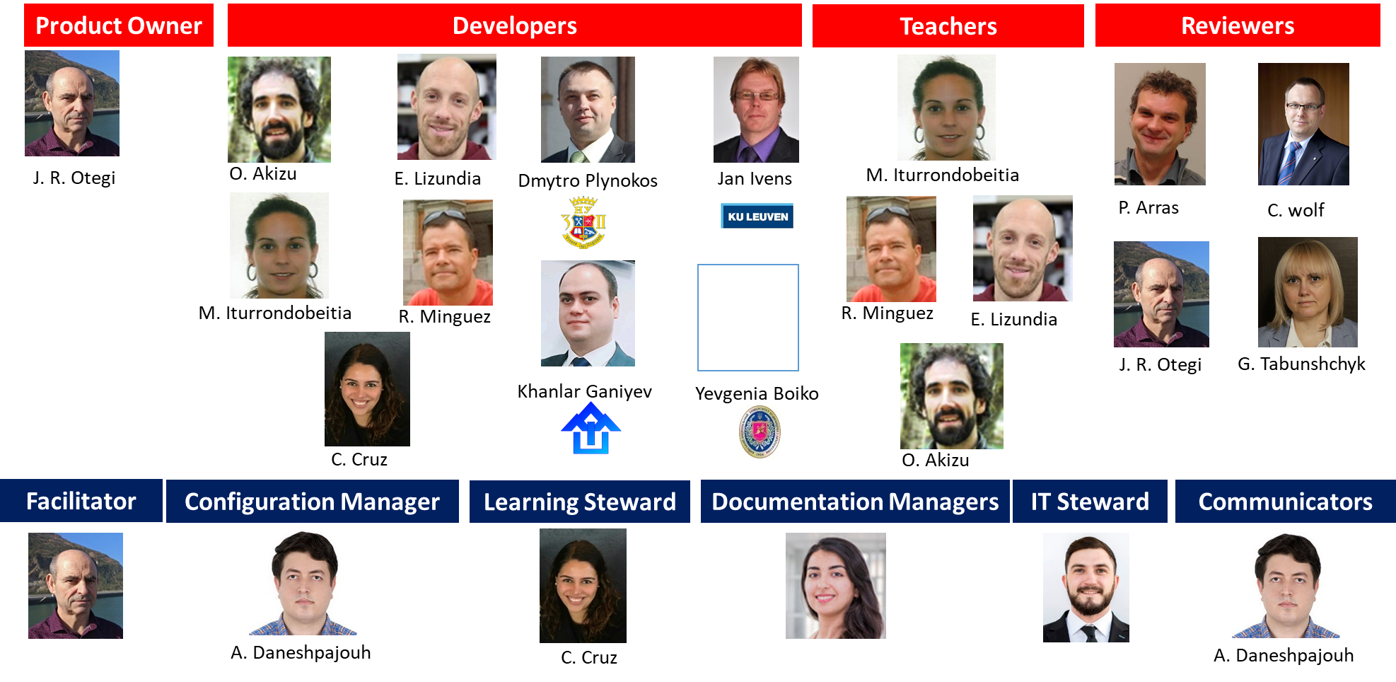
Roles in OpenCoPs – Example for M08 in WORK4CE

Slide 9
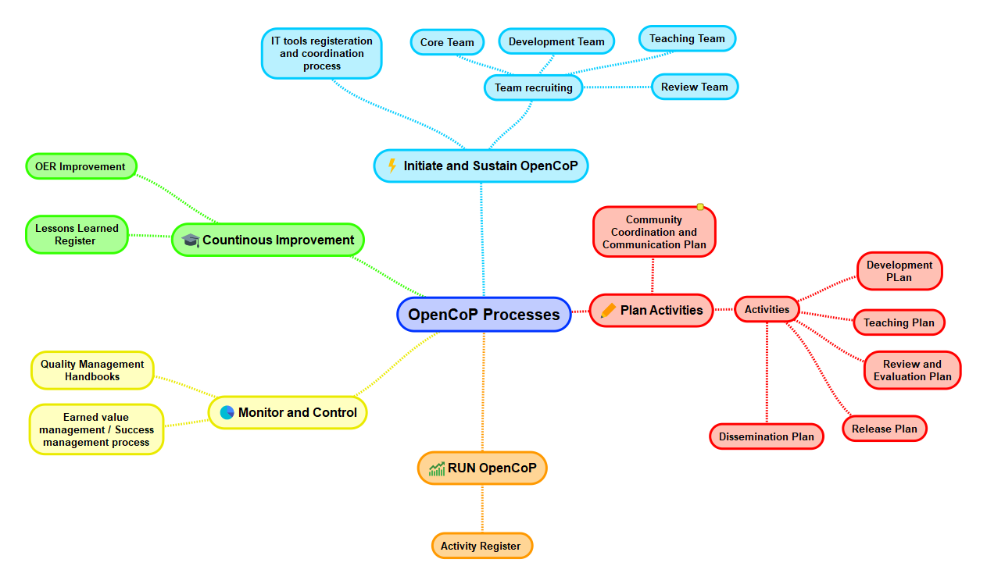
Open-CoPs Proceses

Slide 10





Roles in Proceses
Recruiting
IT Tools Reg.
OER
Initiating
Communication
Lessons Learned
Continuos Improvement
Plan Activities
Activities Plan
Dissemination
Quality
Monitor and Control
Run Open CoPs
Value Delivery
Run Activities
Sustaining

