Slide 1
Cross-domain competences for healthy and safe work in the 21st century – WORK4CE Open Communities of Practice (OpenCoP) Erasmus+ KA2 CBHE 619034-EPP-1-2020-1-UA-EPPKA2-CBHE-JP

Slide 2
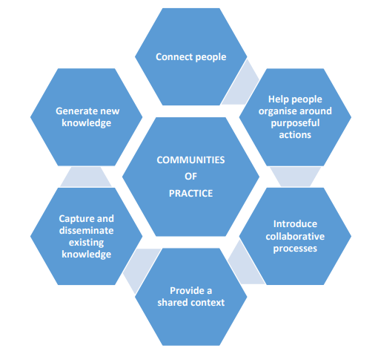
OpenCoP

Slide 3
Module Development
eLearning
Module
(moodle)
OpenCoP develops eLearning module
Digital Education
Ecosystem (DEE)
OpenCoP teaches
eLearning module
Open Community
of Practice
(OpenCoP)
OpenCoP improves
eLearning module
(pilot)
teaching

Slide 4
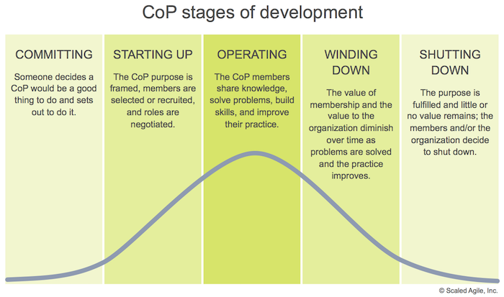
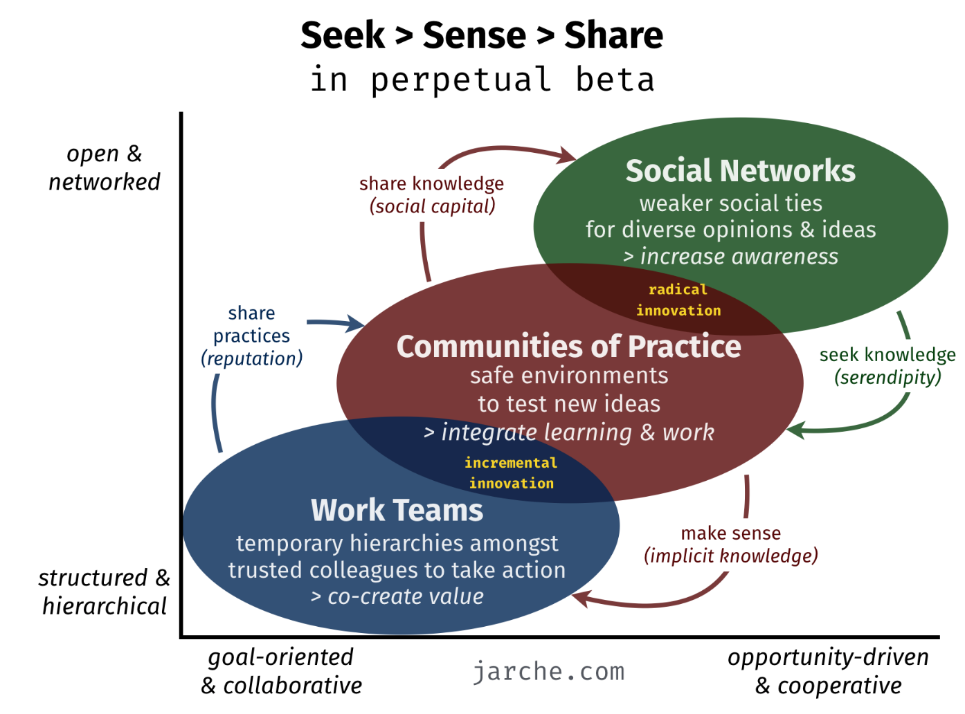
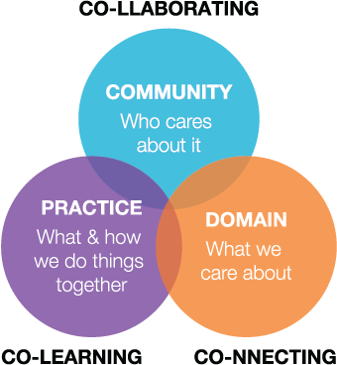
OpenCoP

Slide 5
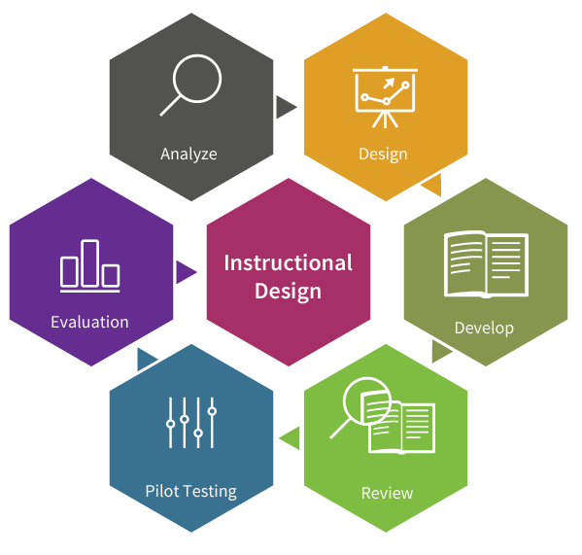
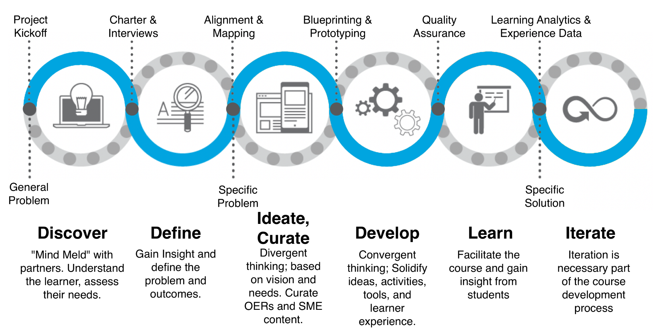
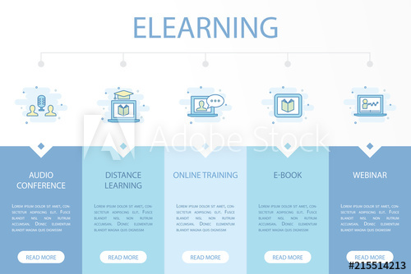
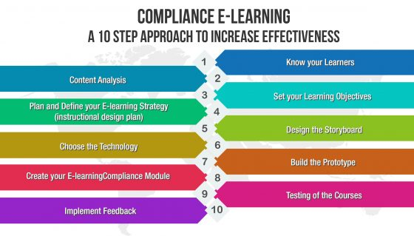
eLearning Module

Slide 6
Summary
An Open Community of Practice (OpenCoP) is:
team organization: create new knowledge, facilitate exchange, learning from each other
“Open”: join and leave the CoP, publish all results as Open Access (Creative Commons, normally CC-BY)
OpenCoPs are an organizational pattern and tool in the context of Open Innovation (Open Knowledge Foundation) and agile practices
expert group: develop, test, improve and maintain a certain set of deliverables
core members: continuously driving the co-creation process, invited experts
life cycle of an OpenCoP: temporary character of the work
develop educational resources on a topic or a new standard

Slide 7
Summary
An Open Community of Practice (OpenCoP) has:
intensive ramp-up phase, a more opportunistic exploitation and maintenance phase and a ramp down phase
community agrees on the work distribution but also on the rights and obligations for using the results
defines a development process for the knowledge and deliverables => co-production process
specification, development, review, test and optimization => incremental process, frequent releases for review, test and evaluation
roles: facilitators, quality managers, developers, testers and reviewers
on-boarding new members (TtT), leaving the community
members take obligations and make contributions and they require a reasonable benefit for them and their organization

Slide 8
Summary
An Open Community of Practice (OpenCoP) are virtual, cross-border communities: IT infrastructure includes:
IT tools for development:
co-authoring tools (e.g. Wikis, like in Git-Book or Atlassian Confluence)
task distribution and management tools (e.g. Kanban board, like Jira)
file sharing and versioning tools (Nextcloud)
conferencing tools
recording and course-authoring tools
Web portal for accessing the tools and workspaces
IT tools for delivery:
Learning Management System (LMS) (e.g. moodle)
virtual classroom system (e.g. BigBlueButton [BBB], zoom or Microsoft Teams)
virtual labs (e.g. SW tools via a Virtual Desktop Infrastructure – VDI)
projects (e.g. a collaboration platform or a code repository like Git)

Slide 9
Digital Education Ecosystem (DEE)
Legend:
will be done by WORK4CE
comes from other projects
Double
Degrees
9 eLearning Modules
Work 4.0
Curriculum Integration
digital & projectized
Competences
Management
competences & content
OER
ECS
eLearning
Community
Server
delivery & didactics
Student Journey
Configurator,
Mobility Planner
expert community
Communities
of Practice
(OpenCoP)
TtT,
Helpdesk
IT Techn. Stewart
EMREX
EWP

Slide 10
OpenCoPs WP1
In Work Package 1: Preparation the following OpenCoPs are initiated:
Digital Education Ecosystem (DEE), Product Owner: FH Do:
Lead partners are DAAD ManDEE and DAAD ViMaCs, WORK4CE is mainly user
FHDo/IDiAL will host the DEE
Trainings and documentation via Technology Stewards
Includes IT-Co-Production Environment
OpenCoPs, Product Owner: KU Leuven and UPV/EHU:
Shared topic with ManDEE and ProDiT (Kaunas STP)
Version 0.1 of the specification is available for the OpenCoPs
IT infrastructure t.b.d. in DEE
Main contribution: Support OpenCoPs, further develop concept, best practices
Didactic Concepts, Product Owner: KNUCA:
Shared topic with ProDiT (KU Leuven )
Version 0.1 of the specification is available for the OpenCoPs
Should involve all academic partners
Module specifications, Product owner: WUNU:
Shared topic with ManDEE and ViMaCs
Version 0.1 of the specification is available for the Module specifications
Should involve all academic partners

Slide 11
OpenCoPs WP2
Work Package 2: Development (Courses):
Data Analytics for Work (DA4W), Product Owner: NU-ZP:
Main Deliverables: Module Specification, eLearning Modules, Cases
Pilot Teaching and Evaluation
Health Management in the Digital Era, Product Owner: FH Do
Industry 4.0, Product Owner: KU Leuven
Distributed Teams (DTW), Product Owner: KNUCA
Work 4.0 (W40), Product Owner: WUNU
Safe Workplaces (SWP), Product Owner: AzUAC
Managing Digital Change (MDC), Product Owner: ASOIU
Life Cycle Thinking and Sustainable Management, Product Owner: UPV/EHU
Developing Digital Business Ecosystems (DDBE), Product Owner: AzUAC
Train-the-Trainer, Curriculum integration into Master programmes, double degrees, EuroDTM label, Product Owner: ASCCA
Modules + Courses have synergy/overlap with ManDEE, ProDiT
Notes:
Include Pilot teaching and evaluation

Slide 12
OpenCoPs WP3
Work Package 3: Quality Plan
3.1 Quality Management Manual, Product Owner: KNUCA with a support of AzUAC:
Document and evaluate the QM process => publish
Suggestions for team: KU Leuven, AzUAC, FH Do
3.2 Data analytics of evaluation survey, Product Owner: WUNU with a support of ASCCA
twice per year a WORK4CE Statistics Report is released
set up the data analytics tools based on MS Excel and data warehouse tools
3.3 Improvement Plan, Product Owner: KU Leuven
IT, Ticket System
Plan the improvement iterations
3.4 Internal Evaluation Board, Product Co-owners: NU-ZP and KU Leuven

Slide 13
OpenCoPs WP4
Work Package 4: Dissemination & Exploitation:
4.2 Certification of modules by IPMA, ECQA, Product Owner: KNUCA
Consultation and audit
Certification of modules
4.3 Communication & Marketing, Product Owner: UPV/EHU:
Plan, organize, curate and control the publishing and communication
Event management: also events organized by IEEE TEMS and EuroPIM

Slide 14
How to get started
An Open Community of Practice (OpenCoP) gets established and started by:
Collecting the initial members => contact product owner (till 12.03.2021)
Establish IT-Infrastructure for work => FH Do
Kick-off => until end of 04/2021, invited by product owner
Role assignment => maintained by product owner
Training and instruction
Collect material & requirements
Specification Document (Wiki, living document)=> check template till 26.03.2021
Develop content (MVP approach)
Organize review with IEB (contact KU Leuven)
Release and plan pilot teaching/use and evaluation
Review evaluation and enter improvement loop
Generate release plan, development process => align with Project Core Team and Work Package Leader …

